Slide 1
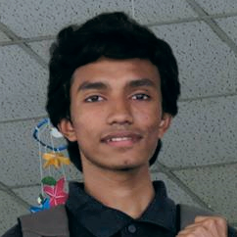

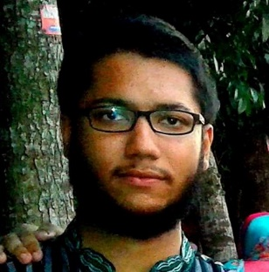

IEEE VIP CUP 2018
Lung Cancer Radiomics Tumor Region Segmentation
DSP Research Laboratory
Uday Kamal
Abdul Muntakim Rafi
Md. Rakibul Hoque
Dr. Md. Kamrul Hasan
Team Spectrum
    Bangladesh University of Engineering and Technology (BUET)
Speech:
Good evening everyone. Welcome to our presentation on this years IEEE Video and Image Processing Cup, which was Lung Cancer Radiomics Tumor Region Segmentation
I am Uday Kamal from team Spectrum, my other team members are Abdul Muntakim Rafi, who is here with me and Md. Rakibul Hoque as well as Prof. Dr. Md. Kamrul Hasan from Bangladesh University of Engineering and Technology.
#First of all, I would especially like to thank this years ICIP organizers for doing everything #possible from their end to ensure our participation today.
Now, without further delay, I would like to start our presentation.

Slide 2
Presentation Outline
DSP Research Laboratory
Dataset
Methodology
Evaluation
Summary
Overview
Challenges
Architecture
Results
    Bangladesh University of Engineering and Technology (BUET)
Speech:
Here is the outline of our presentation.
At first, we will talk about this years problem statement and the provided dataset.
Next, we will identify some key challenges associated with this problem.
After that, we will present our methodology and architecture to solve this problem
And finally, we will cover evaluation criterias and our results in details.

Slide 3
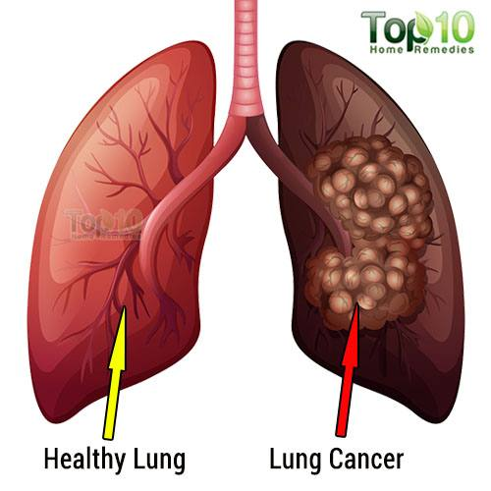
Overview
Significance of the Problem
  Lung cancer is the leading cause of cancer death around the world
  Men have a lifetime risk of 1 in 15 and women 1 in 17
  About 14% of all new cancers are lung cancers
  More than 80% of patients will survive for at least a year if diagnosed early
DSP Research Laboratory
Noninvasive Diagnosis of Lung Cancers
  Major steps
    - Detection
    - Segmentation
    - Classification
Imaging Modality Used
  CT Imaging
    Bangladesh University of Engineering and Technology (BUET)
Speech:
First of all, let us have an overview of the automated diagnosis of lung cancer.
As we all know, CT scan machine generates volumatic data from which we get tomograms or slices of human body.
From these slices, location of abnormalities or tumors are detected by generating binary mask.
These informations are then further analysed to detect whether the tumor is cancerous or non-cancerous and the patient is treated accordingly.
The main focus of this competition is to locate tumorous regions from 2D slices of CT scans.

Slide 4
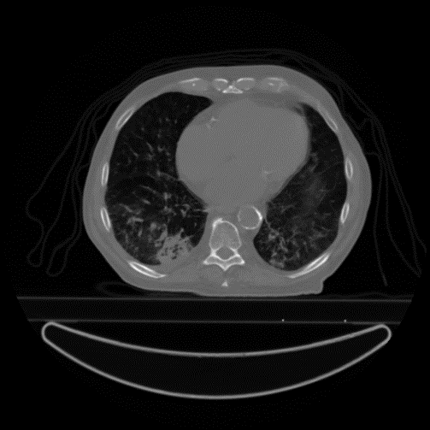

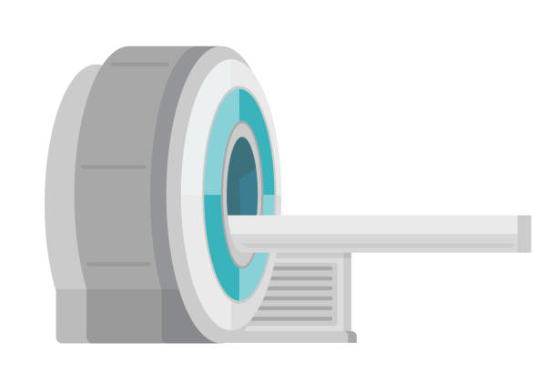

Automated Diagnosis- Lung Tumors
Competition
Challenge
DSP Research Laboratory
CT Scan Machine
CT Scan Images
Segmentation
Tumor Region
Diagnosis critically depends on segmentation
Classification
Treatment Plan
Lung Tumor Segmentation
    Bangladesh University of Engineering and Technology (BUET)
Speech:
First of all, let us have an overview of the automated diagnosis of lung cancer.
As we all know, CT scan machine generates volumatic data from which we get tomograms or slices of human body.
From these slices, location of abnormalities or tumors are detected by generating binary mask.
These informations are then further analysed to detect whether the tumor is cancerous or non-cancerous and the patient is treated accordingly.
The main focus of this competition is to locate tumorous regions from 2D slices of CT scans.

Slide 5
Dataset & Problem Overview
DSP Research Laboratory
IEEE VIP Cup 2018 Problem
Lung Tumor Segmentation
Dataset Overview
 | Train | Validation | Test | Total
No of Patients | 260 | 40 | 40 | 340
No of Slices | 30949 | 4482 | 5115 | 40546
Provided by: The Cancer Imaging Archive (TCIA)
    Bangladesh University of Engineering and Technology (BUET)
Speech:
In this competition, we were provided with a dataset consisting of total 340 patients, which was split into train, validation and test section. Ground truth label was provided only for training and validation data.

Slide 6
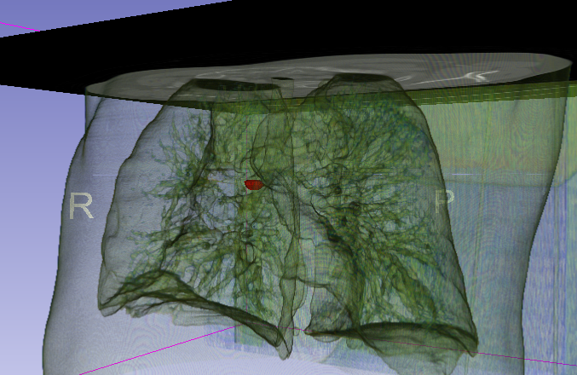
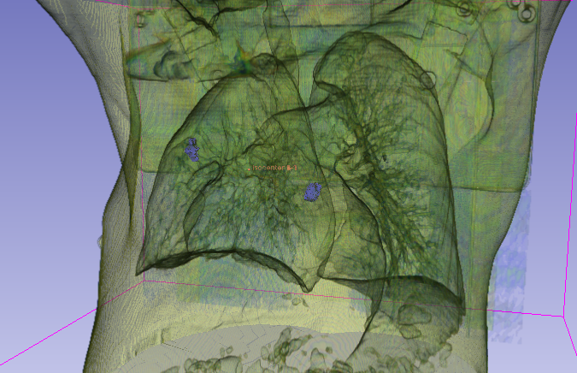
Challenging Scenario
DSP Research Laboratory
Small Tumor
Presence of Small Tumors in Multiple Slices
Position of Tumor
Difficulty of identifying tumors in terminal slices
Presence of multiple tumors in a slice
Small Tumor
Multiple Tumors
    Bangladesh University of Engineering and Technology (BUET)
Speech:
There were some key challenges that we faced working on this dataset.
-First, There were very small tumorous regions.
-Then there were tumors in terminal slices which were difficult to localize.
And finally some patients had multiple tumors in their slices.

Slide 7
Brief Literature Review
Lung Tumor Segmentation
DSP Research Laboratory
Manual Feature Extraction Based Methods
Data Driven Learning Based
Methods
e.g.: Deep Learning Based CNN Models
e.g.: Thresholding Methods, Morphological Methods, Deformable Models , Graph-cut Mechanisms etc.
    Bangladesh University of Engineering and Technology (BUET)
Speech:
The existing methods of Lung Tumor Segmentation can be categorized into two sub section:
First, Manually Extracted Feature based methods, where different handcrafted features are used to identify tumorous region. Among them thresholding methods, morphological methods, deformable methods etc. are notable.
The other category is data driven method, where the useful features are learnt inherently. Various deep learning based methods fall into this category.

Slide 8
Our Approach: Key Features
Deep Learning Based Method
DSP Research Laboratory
  High accuracy and low inference time
3D instead of 2D
  To utilize the inter-slice relation of the tumor
Morphological Post-Processing
  To improve the performance of deep learning models
    Bangladesh University of Engineering and Technology (BUET)
Speech:
Now we will describe the intuitions behind our approach:
First of all, we adopted Data driven method to address the problem. because CNN based Deep Neural Networks have performed exceptionally well in different medical image segmentation problems with high accuracy and low inference time.
And, we used 3d volumetric data so that our model can learn the inter slice relation and continuity of the tumorous region.
Finally, thresholding and morphological postprocessing were applied on the output probability to improve the performance.

Slide 9
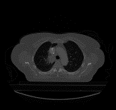
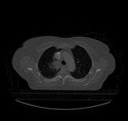
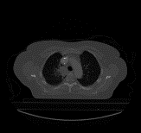
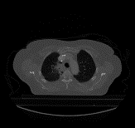
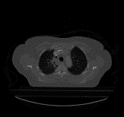

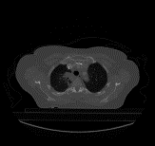
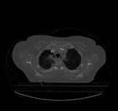








3D CNN Based Methodology
During Testing
During Training
Data Augmentation
3D-Patch
Rotate &
Cropping
Interpolation
DSP Research Laboratory
Input
Augmentation
(a) 3D- Rotation
+
=
Random Global Shifting
(d) Left-Right Flip
8 consecutive slices
X
=
Random Global Scaling
Pre-Processing
(b) 3D Shifting and Scaling
*Median
*Gaussian
*Average
+
=
1
Localizer
Random Noise addition
Blurring
2
3
4
X
=
(e) 2D- Blurring
5
6
7
Random Noise Multiplication
8
(c) Noise Addition
`
Output
Thresholding
Dilation
3D Patch
Normalized
3D Patch
INPUT
    Bangladesh University of Engineering and Technology (BUET)
Speech :
Now we will describe our methodology.
The input data is created by taking 8 consecutive slices together and normalizing
them. Then different types of augmentations such as random rotation, shifting, scaling,
noise addition etc were applied.
Then it was fed to our localizer model which outputs the binary segmentation
masks.
During testing, the same procedure is followed and further post processing was
applied on the output mask probabilities.

Slide 10
Localizer for Tumor Detection
Block Diagram
INPUT
Encoder
DSP Research Laboratory
Successive Contracting block to capture the context
ENCODER
BLOCK
To learn the high level features
ENCODER
BLOCK
LSTM
LSTM
BLOCK
To learn the recurrent inter-slice dependent features
LSTM
BLOCK
Used at the end of encoder block to reduce computational complexity
DECODER
BLOCK
DECODER
BLOCK
Decoder
High resolution features from the contacting path are combined to achieve precise localization
OUTPUT
    Bangladesh University of Engineering and Technology (BUET)

Slide 11

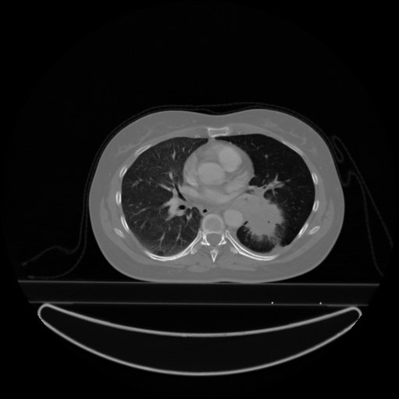
Localizer
Architecture
Dense Connections
Dense Connections
DSP Research Laboratory
3D CT SCAN
SLICES
BINARY OUTPUT
MASKS
DECODER BLOCK
ENCODER BLOCK
DECODER BLOCK
ENCODER BLOCK
Conv2D_LSTM
input
input
input
input
3D
DECONVOLUTION
CONV3D
BN
RELU
DECONVOLUTION
CONV3D
BN
RELU
CONV3D
BN
RELU
CONV3D
BN
RELU
CONV3D
BN
RELU
CONV3D
BN
RELU
TIME
DISTRIBUTED
MAXPOOL2D
Recurrent connection
TIME
DISTRIBUTED
MAXPOOL2D
CONV3D
BN
RELU
CONV3D
BN
RELU
output
SPATIAL
DROPOUT
3D
output
SPATIAL
DROPOUT
3D
Concatenate
output
output
    Bangladesh University of Engineering and Technology (BUET)

Slide 12

Training for MASK Generation
INPUT Volume Data
256 X 256 X 8
OUPUT Binary Mask
No. of Patients | 260
No. Slices Per Patient | ~110
Total No. of Tumor Slices | ~2200
Frame Size | 512 X 512
DSP Research Laboratory
Training Parameters:
Batchsize = 2
Epoch = 30
Loss function =
Optimizer = Adam
Initial Learning Rate = 10⁻³
where, X=predicted & Y = ground truth
BINARY OUTPUT
MASKS
3D CT SCAN
SLICES
$1 −\frac{2(X⋂Y)}{X⋃Y}$,
resize
(512 X 512)
(256 X 256)
DECODER BLOCK
ENCODER BLOCK
Computational Platform:
CPU: Intel Core-i7
GPU: Nvidia 1080 Ti with dedicated memory of 11 GB
RAM: 32 GB DDR4
CONV3D
BN
RELU
input
Conv2D_LSTM
DECONVOLUTION
input
CONV3D
BN
RELU
CONV3D
BN
RELU
TIME
DISTRIBUTED
MAXPOOL2D
Recurrent connection
CONV3D
BN
RELU
output
SPATIAL
DROPOUT
3D
Concatenate
output
    Bangladesh University of Engineering and Technology (BUET)
Speech 10:
Now we will talk about the training procedure in details.
Here we can see the detailed specifications of our training data.
Due to memory constrains and hardware limitation, the initial 512X512 frame size was reduced to 256X256. As we have previously mentioned
the input and output volume data has a dimension of 256X256X8.
Among some important training parameters, we have used batchsize of 2, No. of epochs 30, Adam as optimizer, and initial learning rate of 10^-3.

Slide 13
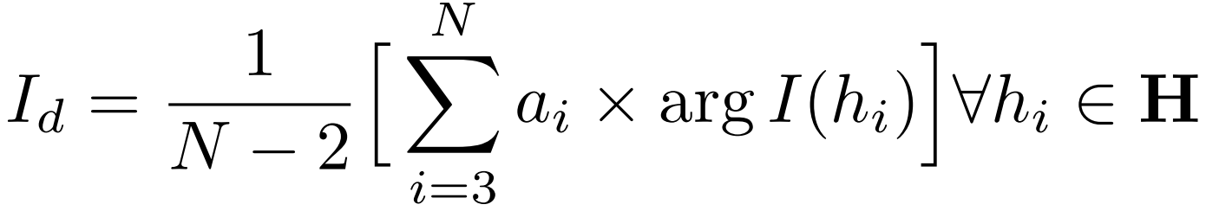
Thresholding for Binary Mask
Intensity Threshold
Evaluation Pipeline
Evaluation Pipeline
DSP Research Laboratory
Hard Thresholding of Output Probalities
Input
Input
0.4 0.1 0.7 0.9 0.6 0.5
0.3 0.1 0.8 0.8 0.5 0.3
0.2 0.7 0.9 0.9 0.7 0.5
0.2 0.8 0.9 1.0 0.8 0.4
0.3 0.1 0.6 0.8 0.9 0.3
0 0 0 0 0 0
0 0 0 0 0 0
0 0 0 0 0 0
0 0 0 1 0 0
0 0 0 0 0 0
0 0 0 1 0 0
0 0 0 0 0 0
0 0 1 1 0 0
0 0 1 1 0 0
0 0 0 0 1 0
Localizer
Output Probabilities
Threshold = 1.0
Localizer
Threshold = 0.9
0 0 0 1 0 0
0 0 1 1 0 0
0 0 1 1 0 0
0 1 1 1 1 0
0 0 0 1 1 0
0 0 1 1 0 0
0 0 1 1 0 0
0 1 1 1 1 0
0 1 1 1 1 0
0 0 0 1 1 0
Adaptive Thresholding
H : Histogram sorted in descending order
N : Number of histogram bins
arg I(h_{i} ): Intensity at histogram bin h_{i}
a_{i} : Corresponding Coefficients
I_{d}: Adaptive intensity threshold
`
`
Thresholding
Thresholding
Dilation
Output
Dilation
Threshold = 0.8
Output
Threshold = 0.7
    Bangladesh University of Engineering and Technology (BUET)
    Bangladesh University of Engineering and Technology (BUET)
    Bangladesh University of Engineering and Technology (BUET)

Slide 14
Post Processing (Dilation)
Evaluation Pipeline
Evaluation Pipeline
Dilation
0 0 1 1 1 0 0
0 1 1 1 1 1 0
1 1 1 1 1 1 1
1 1 1 1 1 1 1
1 1 1 1 1 1 1
0 1 1 1 1 1 0
0 0 1 1 1 0 0
DSP Research Laboratory
Input
(7 X7 ) Circular Mask
Localizer
`
Output
Thresholding
Dilation
Original Slice
Segmented tumor
Predicted mask
(before dilation)
Predicted mask
(after dilation)

Slide 15
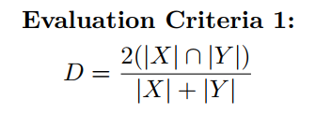
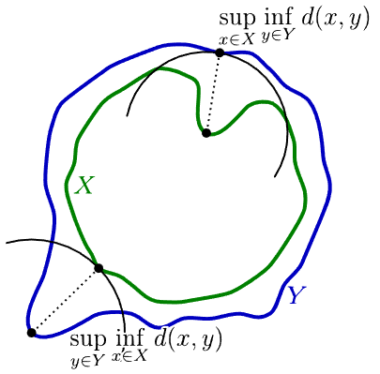
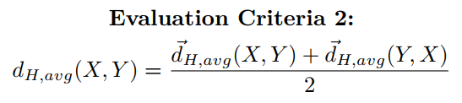
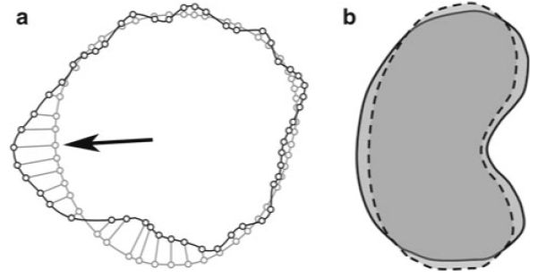
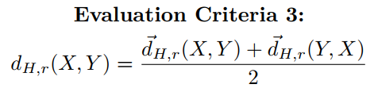
Evaluation Criteria & Results
Dice Coefficient:
1. Dice Coefficient:
Criteria Based Results
Also Calculated:
X
Y
Criteria 1:sdf
higher
Criteria 1:sdf
X: Ground Truth Region
Y: Predicted Region
DSP Research Laboratory
No. of false positive slices
No. of false negative slices
4. No. of false positive slices = False Detection
5. No. of false negative slices = Failed Detection
X∩Y
lower
Mean surface distance:
2. Mean surface distance:
Criteria 2:sdf
lower
Criteria 2:sdf
Threshold
Threshold
Threshold
Selected
Threshold = 0.7
Hausdorff distance (95% Hausdorff distance):
3. Hausdorff distance (95% Hausdorff distance):
Maximize Dice Score & Minimize other metrics
Criteria 3:sdf
Criteria 3:sdf
Threshold
Threshold
    Bangladesh University of Engineering and Technology (BUET)

Slide 16
Evaluation: Threshold Selection
Adaptive vs Fixed Threshold
However, we have chosen Fixed Threshold in this scenario!!
DSP Research Laboratory
Dilation Effect:
    Bangladesh University of Engineering and Technology (BUET)

Slide 17
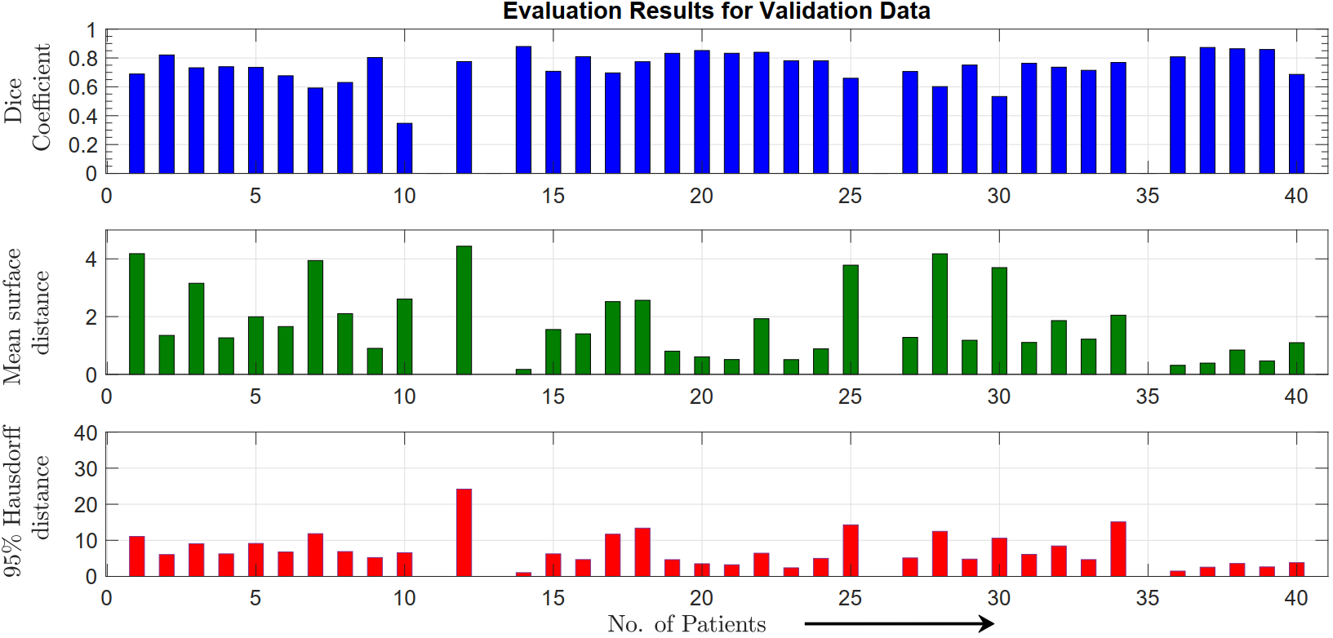
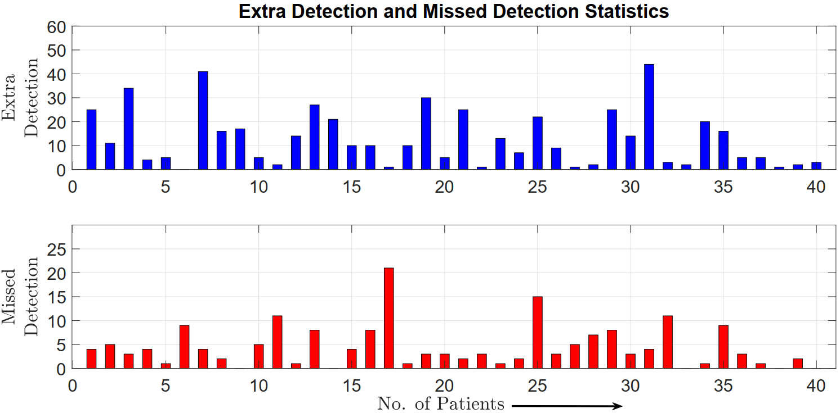
Results
Patient-wise evaluation:
DSP Research Laboratory
Dice Coefficient
Average 0.740
Total 316
Mean Surface
Distance
Average 1.791
95% Hausdorff
Distance
Total 260
Average
7.249
    Bangladesh University of Engineering and Technology (BUET)

Slide 18
Summary
Proposed a recurrent encoder-decoder based 3-D CNN architecture to segment lung tumors from CT-Scans
Thresholding (output probabilities) and morphological post-processing were performed to improve the performance
Achieved an average Dice Score of 0.74 , Mean Surface Distance of 1.71, and 95% Hausdorff Distance of 7.249 on the validation dataset.
Improvements can be done by finding an optimum threshold using a data adaptive algorithm
DSP Research Laboratory
    Bangladesh University of Engineering and Technology (BUET)

Slide 19
DSP Research Laboratory
Thank You !
    Bangladesh University of Engineering and Technology (BUET)

Slide 20
Contacts
Uday Kamal
DSP Research Laboratory
uday2014@gmail.com
Abdul Muntakim Rafi
abdulmuntakimrafirafi@gmail.com
Md. Rakibul Hoque
rakibul_hoque@gmail.com
Dr. Md. Kamrul Hasan
https://khasan.buet.ac.bd
khasan@eee.buet.ac.bd
    Bangladesh University of Engineering and Technology (BUET)

